Slide 1

2024 – 2025 Budget

Slide 2
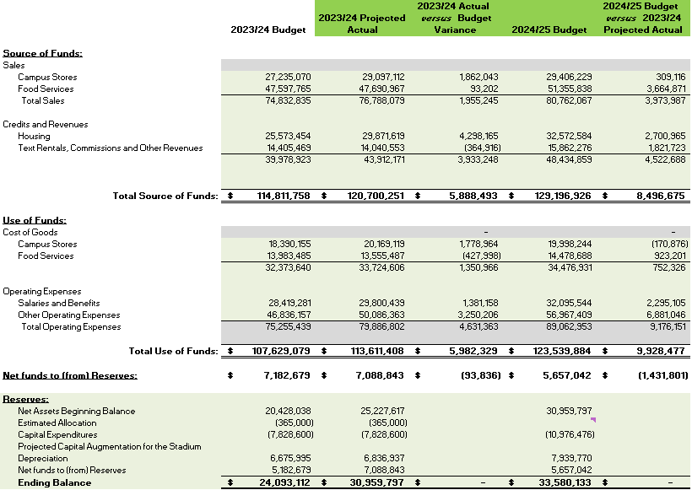
Budget Summary

Slide 3
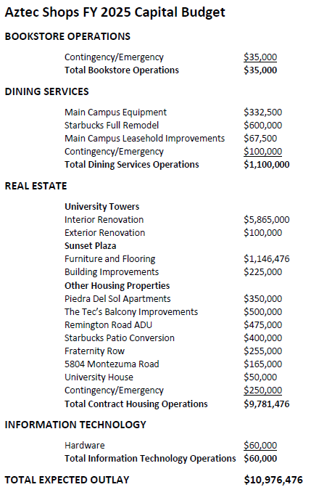
Capital Budget

